Slide 1



Basic Data Cleaning with Titanic Dataset
Step-by-step guide for beginners in data science.
Learn essential techniques for preparing datasets.
by Aravind K
Notes:
1

Slide 2
Titanic Dataset Overview
Dataset Content
Prediction Goal
Cleaning Objective
Passenger information from ill-fated Titanic voyage.
Survival likelihood based on passenger characteristics.
Prepare data for accurate analysis and modeling.
Notes:
2

Slide 3

Loading the Dataset
Import Pandas
1
Essential library for data manipulation in Python.
Read CSV File
2
Load Titanic dataset into DataFrame.
Initial Inspection
3
Display first rows using df.head().
Notes:
3

Slide 4

Identifying Missing Values
1
Use isnull().sum()
2
Data Quality Assessment
3
Visualize Results
Detect and count missing values in dataset.
Display columns with missing data.
Crucial step for understanding dataset completeness.
Notes:
4

Slide 5




Handling Missing Values
Drop Cabin Column
Fill Age
Fill Embarked
Remove due to high percentage of missing data.
Use median to replace missing age values.
Replace with mode (most frequent value).
Notes:
5

Slide 6
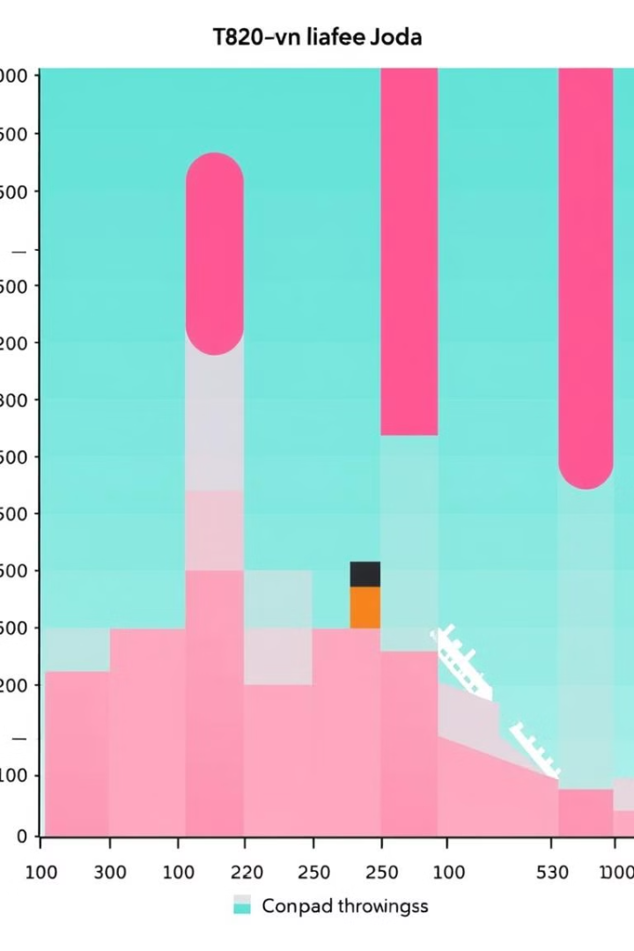
Outlier Detection
Import Libraries
Use matplotlib and seaborn for visualization.
Create Box Plot
Visualize Fare distribution to identify outliers.
Analyze Results
Identify data points outside normal range.
Notes:
6

Slide 7
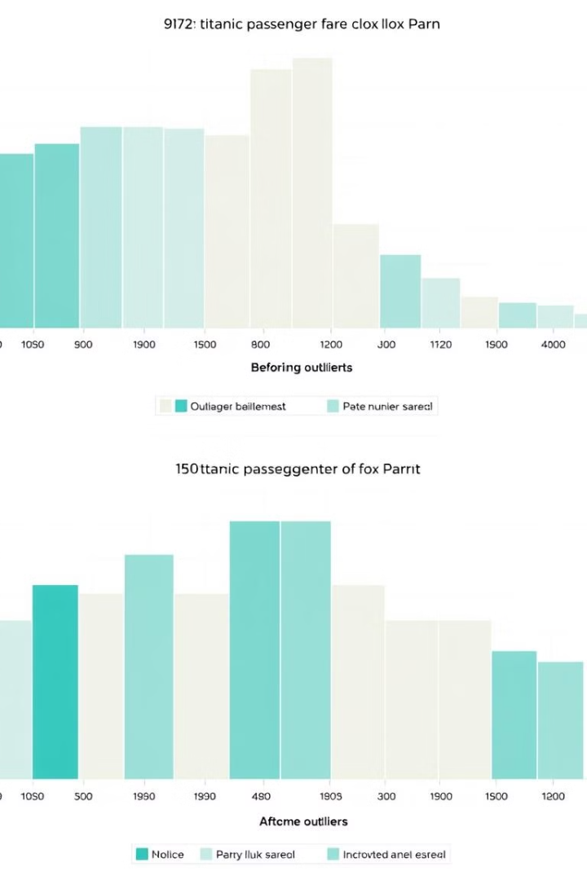
Handling Outliers
Calculate Upper Limit
1
Use 95th percentile of Fare column.
Cap Outliers
2
Replace values above limit with upper limit value.
Visualize Changes
3
Create new box plot to confirm outlier treatment.
Notes:
7

Slide 8

Basic Data Exploration
Command
Purpose
df.describe()
Statistical summary of dataset
value_counts()
Frequency of categorical variables
Visualization
Understand data distribution
Notes:
8

Slide 9




Data Cleaning Summary
Dataset Cleaned
Missing Values Handled
Outliers Treated
Titanic data prepared for analysis and modeling.
Extreme values managed for improved model performance.
Effective strategies applied to address data gaps.
Notes:
9

